Slide 1
Pay and Personnel Center
CAPT John Henry
Commanding Officer

Slide 2
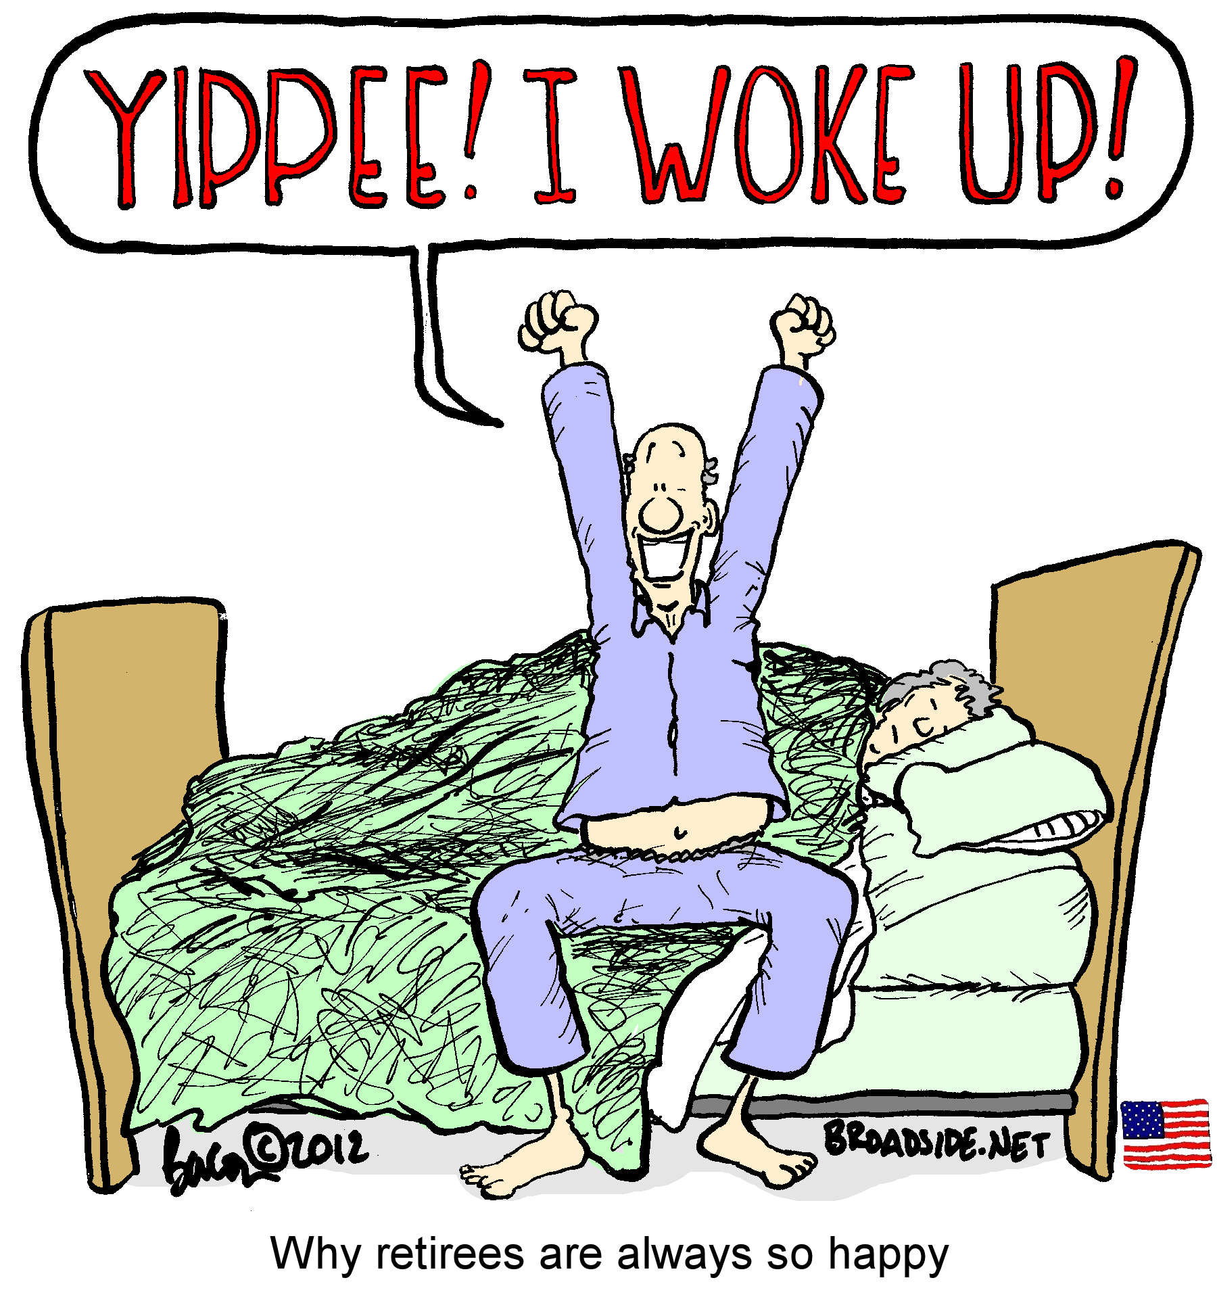
Pay and Personnel Center

Slide 3
Pay and Personnel Center
Command Philosophy
Be human first
Do the right thing
Take care of your shipmates
Core Values
Commitment to You
Trust
Dependable

Slide 4
Year in Review
Updates to 2023 initiatives
New Phone System installed
Automation of VA compensation in Direct Access
Updated DA Logon
Increase Security Procedures
Tax Year 2024
Notes:
Phone system was installed and came with some pros and cons
- (Pro) Vast increase in reliability (VOIP) so no longer have issues with phone lines down and days of call center unable to receive incoming calls
- (Pro) Additional metrics that help us measure efficiency and quality of phone calls received
- (Con) Limited number of people on hold
- (Con) Unable to transfer internally to other phone lines
Automation of VA Compensation in Direct Access continues
One of the initiatives we did not identify last year but has been a

Slide 5
Outstanding Example
2024 Tax Season
Most Successful Tax Season
Surged manpower internally
Electronic vs. Paper replacement 1099Rs
Wait time reduced to slightly over 3 mins
Communication effort to update DA paid off
Notes:
Over 9000 less abandoned phone calls
Processed 2,069 more tickets
Completed 5,918 more password reset requests
523 duplicate 1099Rs were requested
Compared to 2,756 the year before

Slide 6
Initiatives for 2024
Continued Improvements
Automation in DA for VA Compensation
Decrease processing time for deceased claims
Increase automation of the RET-2 to RET-1 process
Continued focus on improving outdated processes

Slide 7
PPC Asks
Self Service
Many changes can be made instantaneously by member
Annual Account Review
Personal and dependent information
Notes:
Same as last year

Slide 8
Questions
Notes:
High System Enhancement CRQs pending that may be of interest
CRQ000000231247: Automate VA Compensation which is the CRQ attached to the VA Compensation Automation FRD, the requirements document to automate, as much as possible, the reconciliation of USCG data to VA data whenever the USCG receives an updated awards file from the VA. This CRQ is currently being analyzed by C5I with periodic meetings with PPC.
CRQ000000243552: VA Compensation Data Extraction. This CRQ is requesting an ADHOC which RAS uses to be turned into a Report an RAS tech can generate themselves. The ADHOC is pulling VA data from tables in DA to aid an RAS tech in their work so having this information in a more timely manner should definitely increase their efficiency. This CRQ is currently at the PMO.
CRQ000000267062: AEW File Merge for VA Transfer. This CRQ would automate the manipulation of (e.g. adding missing data to) files sent and received to\from the VA which are used to support VA compensation. This CRQ is related to the work being transferred from C5I to PPC. This CRQ is currently at the PMO.
There is additionally one High Priority Mandated Change CRQs that may be of interest:
CRQ000000270534: Retired Pay changes for DoD Trust Fund Transition. This CRQ is still at the PMO.

